Slide 1

Learning Word Embeddings
Matthew Engelhard
Notes:
Last time, we talked about what word embeddings are and why they’re useful,
and then we took a look at VSWEM, a very simple word embedding based model.
Now that we have word embeddings, we can convert text to a sequence of vectors,
making NLP very similar to other sequence and time-series prediction tasks. We’ll explore that in a later lecture.
In this lecture, we’ll dig deeper into the question of what word embeddings are
by exploring how they’re learned; and of course, these two things are very closely related.

Slide 2

From sentence to sequence of vectors.
Look up words individually to obtain their vectors
But where do the vectors come from?
This is a sentence
x_{i}
Notes:
To briefly review, recall that a word embedding, also called a word vector, is simply a numeric vector – in other words, an ordered set of numbers – that is associated with a particular word.
Each word is associated with exactly one vector – it’s a different vector for each word. If we’re working in Python, we can store all the pairs of words and their associated word vectors in a dictionary, which allows us to look up the vector for each word in our text.
So, if we have the sentence ‘this is a sentence’, we can look up the vectors associated with each of these words individually and line them up in order, so that our sequence of words is converted to a sequence of vectors.
The question for today is: where do these vectors come from? And the answer, as usual, is that we’re going to learn them from data – but we're going to take a look at how.

Slide 3
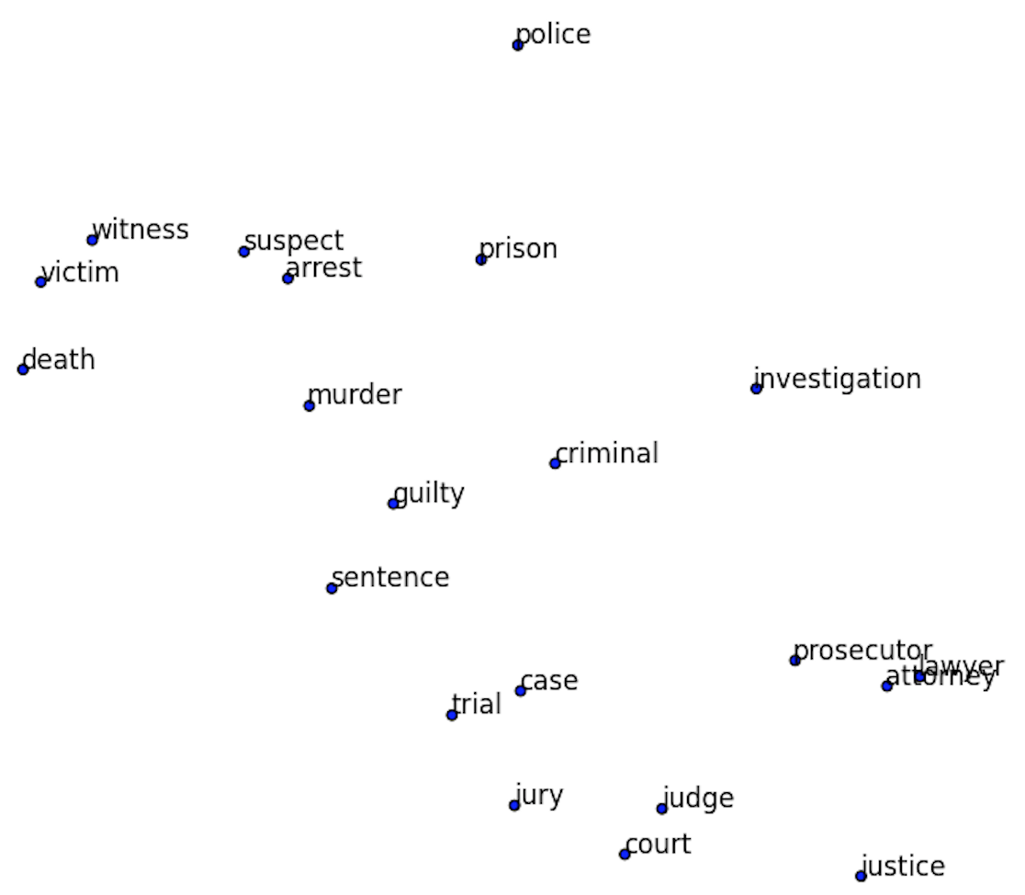
Visualizing Word Embeddings
If the meaning is similar, the vectors (i.e. locations) should be similar!
Notes:
Recall that word vectors for words with similar meanings tend to be close together, and the word vectors for words with different meanings tend to be further apart, so that the distance between word vectors is a measure of the degree of difference in meaning.

Slide 4
How are word embeddings learned?
KEY IDEA: words are defined by the context in which they appear
A woman strolls down the street
A man strolls down the street
A child strolls down the street
A crocodile strolls down the street
A banana strolls down the street
A concept strolls down the street
Notes:
To give you a preview of how we’ll set up the learning problem, I mentioned that we can actually define words by their contexts. If it always makes sense to substitute one word for another in every context in which it might appear, those words are likely to be similar; and if it almost never makes sense, those words are likely to be quite different.
Looking at the example on the slide, the contexts in which the word ‘woman’ appears in normal, written English will be quite different from the contexts in which the word ‘concept’ appears.
And to make this idea a little more precise, let’s define the context of a word, in a text passage, as the set of words surrounding it. We could look at adjacent words only, or we could look at a slightly wider window of size 5, for instance.

Slide 5
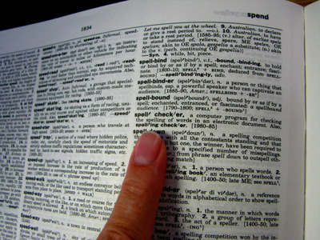
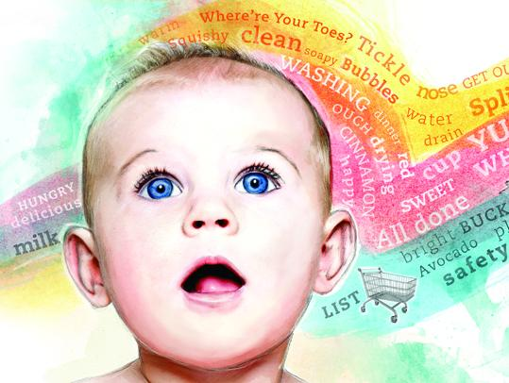
KEY IDEA: words are defined by the context in which they appear
-> if words are always exchangeable, they must have very similar meaning
https://www.parenting.com/activities/baby/teach-baby-to-talk/
learn word meaning like an adult:
explicit definitions
learn word meaning like an child:
implicit definitions from context
Notes:
This is more like the way a child might learn word meanings rather than an adult. As an adult, we often learn new words based on a definition, which requires us to already understand the meaning of the words used in that definition. In contrast, a child learns word meanings by listening to words in context – as well as by speaking and being corrected as needed, but we won’t worry about that for now.

Slide 6
So how do we learn spatial locations for each word?
We want: a vector for each word that allows us to predict its context
(i.e. what other words are likely/unlikely to be around it)
p(man)
p(woman)
elements of the vector corresponding to “strolls”
Logistic regression
p(child)
probabilities for all words in our vocabulary
p(banana)
p(crocodile)
v(strolls)
p(concept)
Notes:
So, how do we set up the learning problem? Informally, we’re defining words based on context.
But to make that idea precise, let’s create a predictive model that encapsulates that intuition.
What we’d like to have is, for each word, a vector that allows us to predict which other words are likely to be nearby, and which words are not
In the example on the slide, we’d like to have a vector for the word ‘strolls’ that allows us to predict which words are likely to be found in its immediate context. The predicted probability of ‘woman’ should be fairly high, and the predicted probability of ‘concept’ should be very low
We’ll need predictions for each word in our vocabulary – again, this is the complete list of words we’re interested in, and for which we’d like to have word vectors. For each of those words, our model will predict the probability that that word will appear in the context of the word ‘strolls’, in this case
With this goal in mind, let’s consider how to set up our prediction task

Slide 7
Predict Context Words from Input Words
We define a context word as one that appears inside a fixed-length window around the input word in our training corpus.
(e.g. Wikipedia)
A man strolls down the street.
input context
{input word, context word}
{strolls, man}
{strolls, woman}
{swims, crocodile}
{swims, fish}
{flies, bird}
{flies, plane}
Notes:
Again, our goal is to take an input word – in this example, ‘strolls’ – and predict the probability that each word in our vocabulary will appear in its context.
What is our training set?
We can crawl through a huge text corpus – it could be Wikipedia, Twitter, randomly collected internet sites, and so on – and sample pairs of words that appear near one another.
We find that strolls appears near man, so {strolls, man} becomes an input word, context word pair
Similarly, we find that ‘flies’ appears near ‘bird’, so {flies, bird} becomes an input word, context word pair
Note that {bird, flies} is also a valid input word, context word pair: if bird appears in the context of flies, then flies also appears in the context of bird – the relationship is symmetric.
We might use a ‘context window’ of length 5, as shown in the slide, so that the input words and context words can be separated by one intervening word at most
Now we’ll create a model that predicts input words from context words

Slide 8
So how do we learn spatial locations for each word?
We want: a vector for each word that allows us to predict its context
(i.e. what other words are likely/unlikely to be around it)
p(man)
p(woman)
close to 1
elements of the vector corresponding to “strolls”
Logistic regression
p(child)
p(banana)
p(crocodile)
v(strolls)
p(concept)
close to 0
Notes:
Again, what we’re going for are word vectors that allow us to predict the context – we’re just not quite there yet.
We’d like to have a logistic regression model that takes the vector associated with the input word and predicts the context word
And in that way we'll say that that vector is a representation of the contexts in which the input word appears.
This is still a classification model, but the number of labels is HUGE – it’s the number of words in our vocabulary
This model will learn from all of the training pairs we’ve created that ‘man’ is likely to appear in the context of strolls, and concept is not

Slide 9
So how do we learn spatial locations for each word?
We want: a vector for each word that allows us to predict its context
(i.e. what other words are likely/unlikely to be around it)
p(man)
p(woman)
elements of the vector corresponding to “swims”
Logistic regression
p(child)
p(banana)
p(crocodile)
closer to 1
v(swims)
p(concept)
Notes:
Similarly, this model will learn from all of the training pairs we’ve created that ‘crocodile’ is likely to appear in the context of ‘swim’, ‘woman’ is also likely, but ‘banana’ and ‘concept’ are not likely

Slide 10
So how do we learn spatial locations for each word?
We want: a vector for each word that allows us to predict its context
(i.e. what other words are likely/unlikely to be around it)
p(man)
p(woman)
These vectors are what we want to learn
Logistic regression
p(child)
p(banana)
We could build this model if we had the vectors; less clear how to get them
closer to 1
p(crocodile)
v(swims)
p(concept)
Notes:
Again, getting to this model is our final goal here, but where these word vectors will come from is still not clear

Slide 11
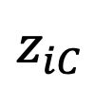
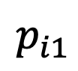
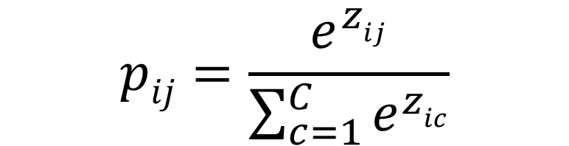
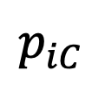
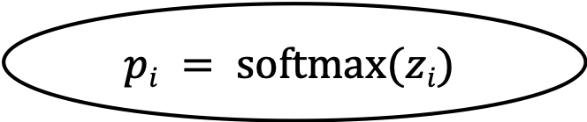
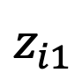
Recall: Multi-Class Logistic Regression
$$p_{i1}$$
$$p_{iC}$$
$$pij=\frac{e^{zij}}{\sum_{c=1}^{C}{e^{zic}}}$$
$$pi = softmax(zi)$$
$$z_{i1}$$
$$z_{iC}$$
x_{i1}
x_{iM}
Notes:
So far we’ve just said it’ll be a logistic regression model, but let’s take a moment to recall what that looks like
The input to the model are the features x_i, which in this case will be the vector of attributes, or features, of our input word
Since we have a multi-class rather than a binary problem – remember, we’re predicting the probability that each word in our vocabulary will appear in the context – we’ll multiply our features by matrix of parameters to obtain the log-odds corresponding to each of those vocabulary words.
How many parameters are required to do this? Our parameter matrix will be the number of input features – this is the number of attributes, or dimensions, in our word embeddings – by the number of words in our vocabulary. It’s going to be a very big matrix.
Then, we’ll convert all the log-odds scores to probabilities using the softmax function, shown on the right.

Slide 12
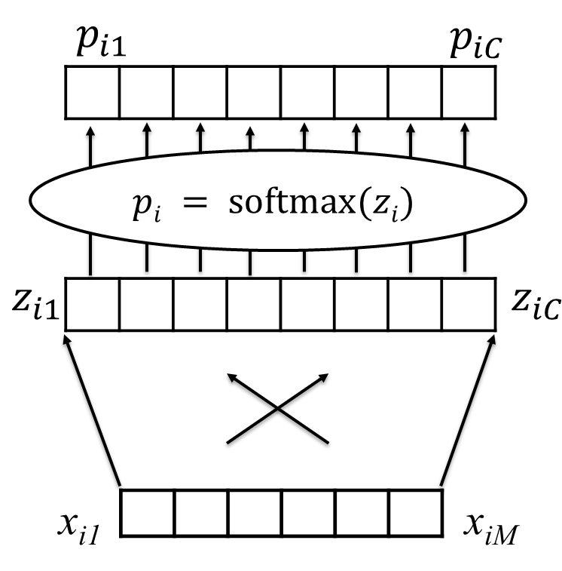
Recall: Multi-Class Logistic Regression
Notes:
So, let’s take that logistic regression diagram from before and flip it on its side – nothing’s changing in the model, we’re just making it easier to fit everything on our slides

Slide 13
Recall: Multi-Class Logistic Regression
z(man)
softmax
p(man)
p(woman)
p(child)
p(banana)
p(crocodile)
v(strolls)
p(concept)
z(concept)
Notes:
And then, instead of our more general notation, we’ll annotate the image to indicate that on the left, we have the vector for the word strolls, in the middle, we have all the log-odds scores for all our vocabulary words, and on the right, we have all the probabilities for all our vocabulary words

Slide 14
We want: word vectors that allow us to predict their likely context
But again, how do we learn these vectors?
Let’s take a step back: we’ll focus on understanding how we can predict context words based on input words
z(man)
softmax
p(man)
p(woman)
p(child)
p(banana)
p(crocodile)
v(strolls)
p(concept)
z(concept)
Notes:
Now that we have an appropriate set up for predicting context words based on the vector associated with the input word, let’s take a step back.
We don’t yet have our word vectors, but we do have a way to represent the input word

Slide 15
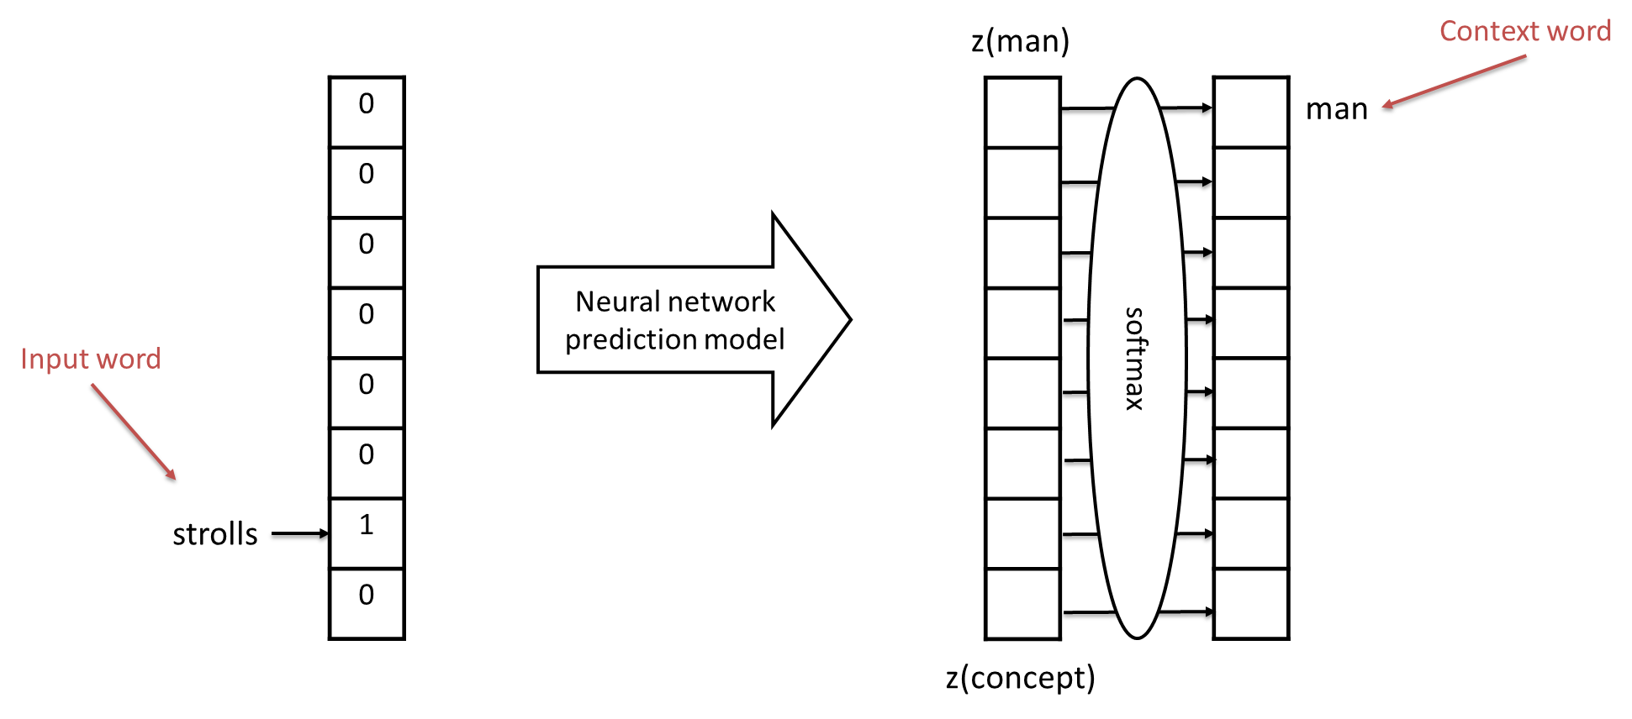
Predicting context words based on input words
Input words and context words are one-hot encoded
(similar to bag of words representation)
Notes:
We’ll represent our input word the same way we represented sentences in our bag of words lecture, namely by taking a vector of all zeros that’s the length of our vocabulary, then placing a 1 in the position that corresponds to that word. In this case, if ‘strolls’ is the one thousandth word in our vocabulary, we’d put a 1 in position one thousand.
Note that during training, our labels – in this case, the correct context word – are created in the exact same way.
Now we have the bare bones of a model that predicts the likely context word based on the input word – what remains is to choose how we connect the two.

Slide 16
Predicting context words based on input words
Training Data:
HUGE number of pairs of the following form:
{input word, context word}
e.g. from Wikipedia
Examples:
{strolls, man}
{strolls, woman}
{swims, crocodile}
{swims, fish}
{flies, bird}
{flies, plane}
Notes:
Once we’ve chosen how to connect them, we can use that training set we described before – the huge number of pairs, likely billions, of input words and context words.

Slide 17
Predicting context words based on input words
Training Data:
HUGE number of pairs of the following form:
{input word, context word}
e.g. from Wikipedia
Examples:
{strolls, man}
{strolls, woman}
{swims, crocodile}
{swims, fish}
{flies, bird}
{flies, plane}
These vectors are huge!
They’re the size of our vocabulary
Notes:
But remember, the input and output vectors for this problem are huge – they’re the size of our vocabulary, which will be many thousands of words.

Slide 18
What’s the simplest model we can possibly use?
First idea:
Directly connect our input to the log-odds layer
These vectors are huge!
They’re the size of our vocabulary
Notes:
What’s the simplest possible way to connect the input to the output?
Well, we could simply connect them directly, as in logistic regression
This seems simple, but will it work?

Slide 19
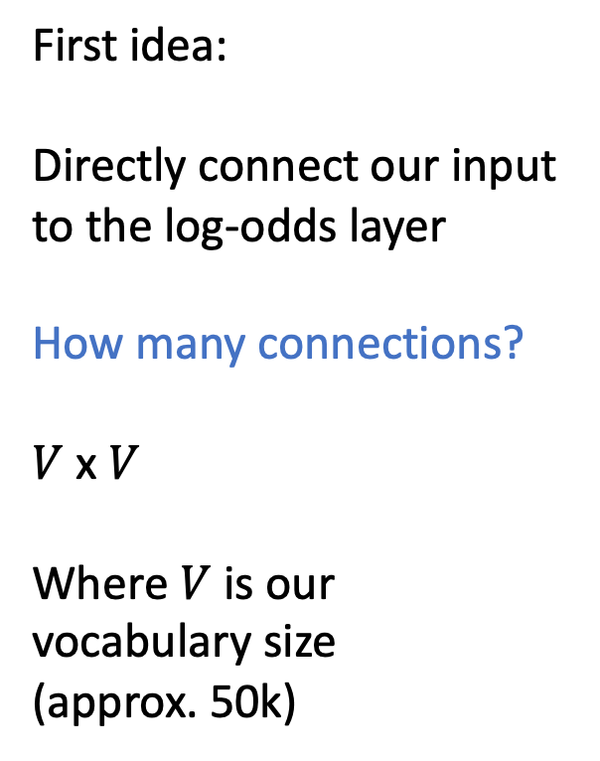
What’s the simplest model we can possibly use?
First idea:
Directly connect our input to the log-odds layer
How many connections?
$V$ x $V$
Where $V$ is our vocabulary size
(approx. 50k)
These vectors are huge!
They’re the size of our vocabulary
Notes:
The problem is that our vocabulary is too large!
Let’s suppose we have 50,000 words in our vocabulary, which is about right – it’s estimated that the average native English speaker knows about 25,000 words
we need to connect all 50,000 input words to all 50,000 output words, so the number of parameters is 50,000 squared, whcih is 2.5 billion!
A model with 2.5 billion parameters actually might be achievable in 2021, but it wasn’t when word vectors were first created
And furthermore, it doesn’t really give us what we’re looking for, which is a compact, numeric vector that represents ‘strolls’

Slide 20
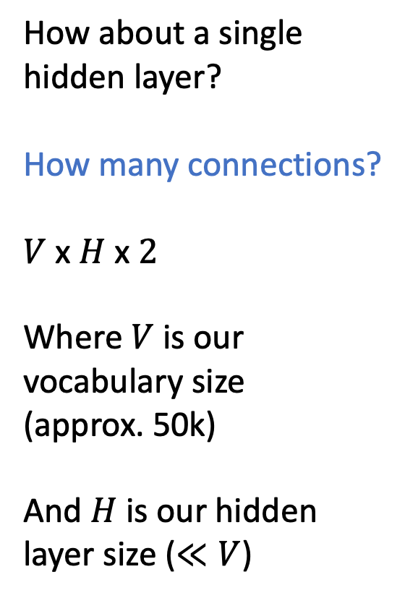
What’s the next simplest?
How about a single hidden layer?
How many connections?
$V$ x $H$ x $2$
Where $V$ is our vocabulary size
(approx. 50k)
And $H$ is our hidden layer size ($≪V$)
These vectors are huge!
They’re the size of our vocabulary
Notes:
So, what’s the next simplest thing we might consider?
Well, we could have a single hidden layer of size H, where H is much smaller than 50k – maybe something like 100.
How many parameters would be in such a model? Well, there would be V x H connections in the first layer – we’re connecting each vocabulary word to each of our hidden units – and there would be H x V connections in the second layer – we’re connecting each hidden unit to the log-odds corresponding to each context word.
For a vocabulary of size 50k and hidden layer of size 100, this gives us 10 million parameters, which is still big, but much less than 2.5 billion.

Slide 21
OK, let’s try it: use a single hidden layer
z(man)
0
0
0
0
0
0
1
0
softmax
1
0
0
0
0
0
0
0
man
strolls
z(concept)
Notes:
So, let’s try it – here’s the architecture we have in mind, with 10 million parameters

Slide 22
Use mini-batches of training examples; minimize cross-entropy loss
z(man)
0
0
1
0
0
0
0
0
softmax
0
0
0
0
0
1
0
0
swims
crocodile
z(concept)
Notes:
We’ll train it using all those training examples we collected from Wikipedia – those {input word, context word} pairs – to minimize the cross-entropy loss between the true context word and the predicted probabilities.

Slide 23
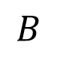
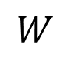
Learn our parameters: Weight Matrices $W$ and $B$
z(man)
0
0
1
0
0
0
0
0
softmax
0
0
0
0
0
1
0
0
swims
crocodile
$$W$$
$$B$$
z(concept)
Notes:
There are two matrices of parameters in this model – we’ll call the first matrix W, and the second B

Slide 24
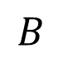
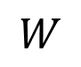
Isn’t this the vector we were looking for?
z(man)
0
0
1
0
0
0
0
0
softmax
p(man)
p(woman)
swims
p(child)
p(banana)
it’s compact
It allows us to predict context words for a given input word
p(crocodile)
$$W$$
$$B$$
p(concept)
v(swims) ??
z(concept)
Notes:
And now, if we step back, we see that the right side of this model looks like the logistic regression model we initially wanted…
The matrix W maps our input word to a small number of features, or attributes – and these features are used in turn to predict which context words are likely vs unlikely.
These features, or attributes – these are exactly what we were looking for – they’re attributes associated with the input word that allow us to predict its context. This is our word vector.

Slide 25
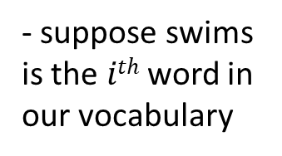
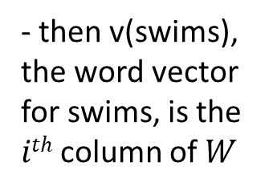
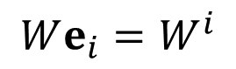
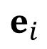
Let’s take a closer look at $W$
$$e_{i}$$
z(man)
0
0
1
0
0
0
0
0
$$We_{i}=W^{i}$$
softmax
p(man)
p(woman)
swims
p(child)
- suppose swims is the $ith$ word in our vocabulary
p(banana)
p(crocodile)
$$W$$
$$B$$
- then v(swims), the word vector for swims, is the $ith$ column of $W$
v(swims)
p(concept)
z(concept)
Notes:
Now if we think about W, finding this vector gets even a little bit easier.
Because when we multiply by our one-hot representation of the input word – again, this is a vector with zeros everywhere, except there’ s a 1 in position corresponding to our vocabulary word -- we’ll call that position I
When we do that multiplication, it’s simply selecting the ith column of our parameter matrix W

Slide 26
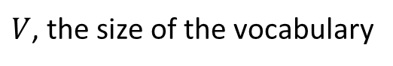
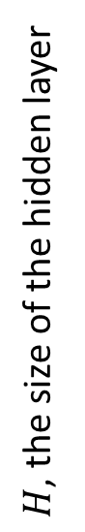
Let’s take a closer look at $W$
$V$, the size of the vocabulary
$H$, the size of the hidden layer
Notes:
So, zooming in on W – it’s a matrix with H rows and V columns, where V is the size of our vocabulary. And the vector we get when our input is our ith vocabulary word is simply the ith column of this matrix

Slide 27
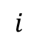
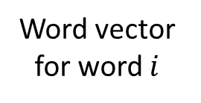
Let’s take a closer look at $W$
$V$, the size of the vocabulary
$$i$$
Word vector for word $i$
$H$, the size of the hidden layer
Notes:
Which is shown here.
This ith column – this is the word vector corresponding to word i in our vocabulary.

Slide 28
We now have a distributed representation of word meaning based on context
z(man)
0
0
1
0
0
0
0
0
softmax
p(man)
p(woman)
swims
p(child)
p(banana)
p(crocodile)
$$W$$
$$B$$
v(swims)
p(concept)
z(concept)
Notes:
So, that’s it! Now we have a compact set of attributes for each vocabulary word that suffices to predict the other words that are likely to be nearby!
If the vectors are similar, the predicted context words will be similar!
If the vectors are different, the predicted context words will be different!
And the degree of difference in two word vectors depends on the degree of difference in the average context for those two words
We can think of these vectors of a ‘dense representation’ of the likely context, meaning that it’s a small number of numeric values that allows us to predict all those context words
This is what is meant by saying that we’re defining words in terms of the context in which they appear.

Slide 29
Important Takeaways:
We are learning a vector representation for each word based on the contexts in which it appears
training data: large number of pairs of nearby words from a large corpus
These vectors give us much more flexibility when modeling: makes text sequences like other sequences
Notes:
So, in summary:

